Slide 1
G440/540 Terrestrial Ecosystem Modeling Overview and History of Terrestrial Ecosystem Modeling
Instructor: Dr Natasha MacBean

Slide 2
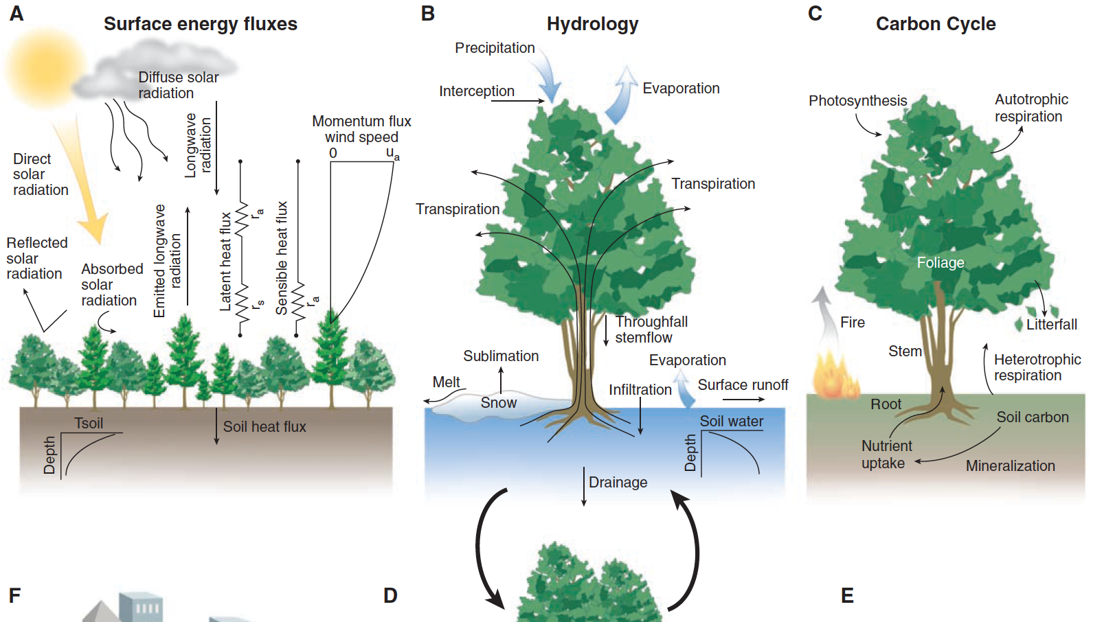
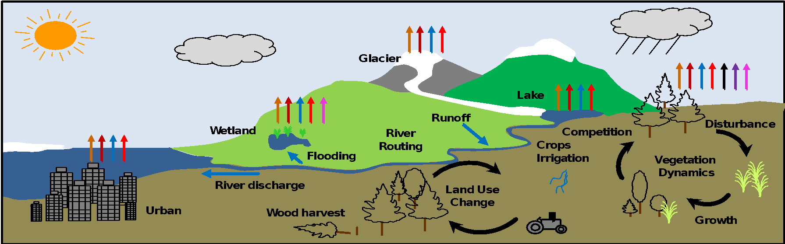
What processes are in TEMs?

Slide 3
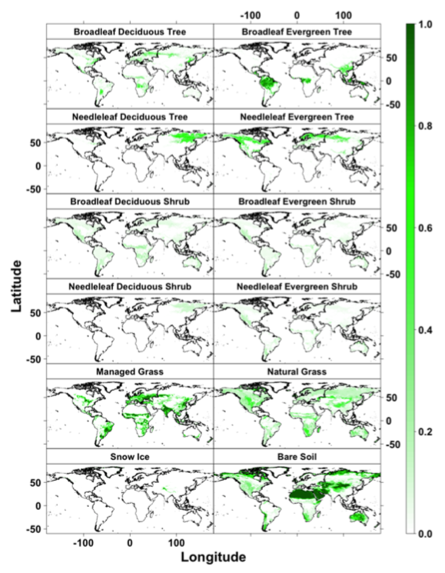
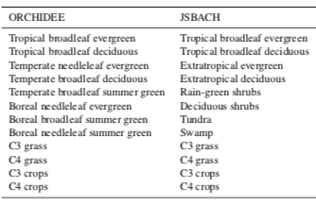
Plant Functional Types
“Groups of plant species that share similar structural, phenological, and physiological traits, and can be further distinguished by climate zone” (Poulter et al., 2015, GMD)

Slide 4
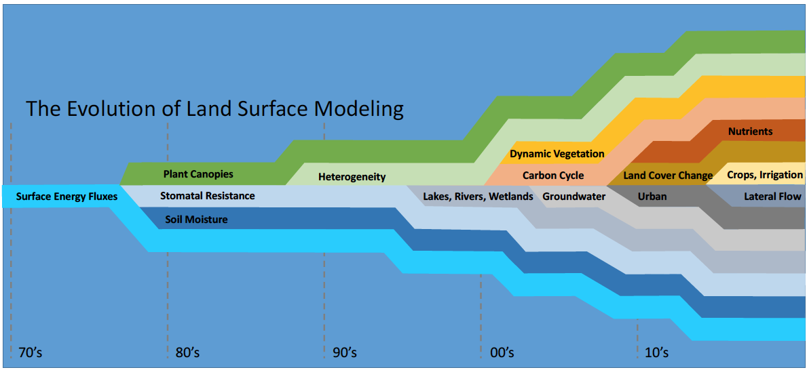
The Evolution of Land Surface Modeling
Nutrients
Dynamic Vegetation
Plant Canopies
Heterogeneity
Carbon Cycle
Land Cover Change
Crops, Irrigation
Surface Energy Fluxes
Stomatal Resistance
Lakes, Rivers, Wetlands
Groundwater
Urban
Lateral Flow
Soil Moisture
70’s
80’s
90’s
00’s
10’s
http://www.cesm.ucar.edu/models/clm/

Slide 5
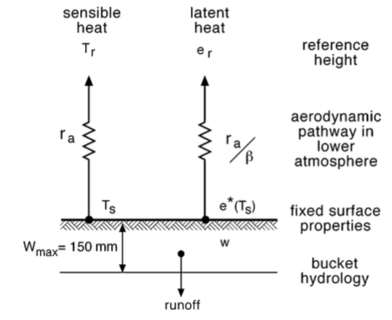
Why is the land surface important for the climate? Follow the evolution of land surface models...
1st generation:
Partition energy into sensible and latent heat
Exchange of water with the surface
From Pitman (2003)
2nd generation:
Addition of vegetation layer (1 type per grid cell) and soil
→ transfer of E and W via canopy
2-layer bucket hydrology + runoff
From Prentice et al. (2015)
Notes:
SAY: Must represent how the surface interacts with the atmosphere and how this interaction will change in future with natural process and human activity. So we bring all our process understnading together formally in models. Models only way to predict how terrestrial biosphere will respond to future global change (climate, humans etc)
In order to understand why the land surface is important we can follow the evolution of land surface models
Also add in importance of ecosystem services: C ressources (food/wood production and climate mitigation) along with water ressources.. (the besoin project)
People consider 2A and 2B 2nd generation models – ***SEE SELLERS AGAIN***

Slide 6
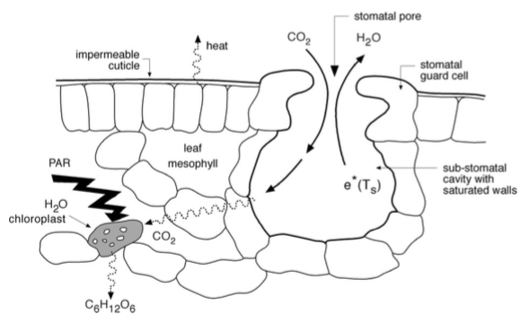
Continued evolution of land surface models
Adapted from Prentice et al. (2015)
3rd generation:
Addition of C cycle via coupling of stomatal conductance and photosynthesis
Two crucial feedbacks of land surface to increasing CO₂ now possible:
physiological effect (on stomatal conductance)
structural effect (CO₂ fertilization)
Notes:
SAY: also Climate feedback…important for modelling the impact of CO2 long term
Subsequent 3rd generation are adding biogeochemical cycles. Ecological models (dynamic vegetation also brought in). Introduction of different plant functional types.
CRUCIALLY FOR 3RD GENERATION → coupling between stomatal conductance and C uptake means increasing CO2 can now have a physiological effect (on gs) and a structural effect (CO2 fertilisation). 2 feedbacks now possible, and NOW we can really study long term changes in the C sink.
BUT also 2 opposing effects of increased CO2 and climate (beta and gamma factors)
ALSO point out that at a time scale of less than ~decades the most important processs are still W and E. But for longer than that we need C coupled (and all the other things that come along with it).

Slide 7
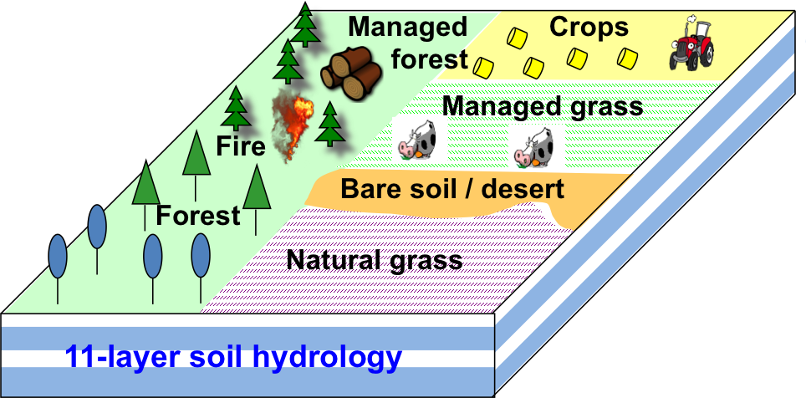
Continued evolution of land surface models → need for more processes
Adapted from Prentice et al. (2015)
3rd generation:
Addition of C cycle via coupling of stomatal conductance and photosynthesis
Nutrient (N and P) limitation on C uptake
Seasonal cycle of vegetation + DYNAMIC veg.
CH₄, wetlands, permafrost
Complex hydrology e.g. river routing, snow
4th generation…?
Forest and grassland management
Land use and land cover change (LULCC)
Crops
Fire
ORCHIDEE LSM
Also see Sellers et al. (1997) Science and Bonan Course textbook for an overview of the history of terrestrial modeling
Notes:
SAY: We need to add in better process representation to answer certain questions, BUT = more uncertainty.
4th generation also good for ecosystem services.
My research so far has been to try to address the uncertainty in LSMs.
- After 3rd generation – still needed more processes
Added N cycle (for nutrient limitation on CO2 fertilisation, and now need P), because need to know what’s going on with C → how much and where etc so we know RF and feedbacks of land to offset emissions (calc compatible emissions)
Different plan functional types
Ecologicl modellers started to work with the Land surface modelers.
PP: insist on the last slide (where you mention 4th generation)
and maybe there insist on the need to represent the "dynamic of vegetation state (phenology, height, density, ....)" to estimate the "biophysical" impact on the atm (bowen ratio, albedo, exchange of momentum,...)
NOTE: no one has mentioned 4th generation yet, and perhaps there would be some discussion as to what constitutes “3B”. But largely I (personally) might say that 4th generation would have a “human activity” element. Say exchange of Water, energy and carbon all the same. Also snow, permafrost, peatlands, CH4 etc.
Also in parallel DVMs ("adaptation" of plants (under changing environnement) is not currently well modeled)
and move towards sub-grid and multi-layer capability → important for regional scales.

Slide 8
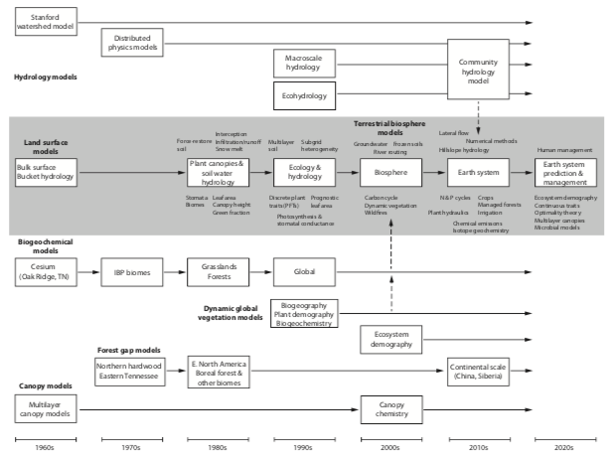
History of models in the context of different classes of models
Bonan, 2019

Slide 9
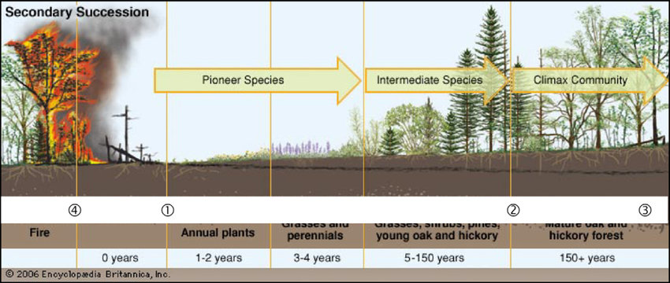
Dynamic vegetation models
Growth
Competition
Co-existence
Exclusion
Recruitment
Mortality

Slide 10
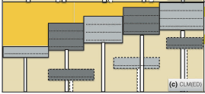
Static vs dynamic vegetation models (and land cover change)
Dynamic vegetation
No vegetation cover prescribed
Vegetation changes dynamically over time
Vegetation changes due to climate envelopes; OR
Vegetation grows/changes over time according to ecological principles of recruitment, succession, species competition etc (vegetation demography models)
Static PFT maps
Derived from satellite data (often land cover products)
Prescribes fractions of each PFT per grid cell
Vegetation doesn’t change over time (except LC change)
Historical land use/cover change
From bookkeeping models and satellite data
Imposed on either static or dynamic vegetation
Fisher et al. (2018), GCB

Slide 11
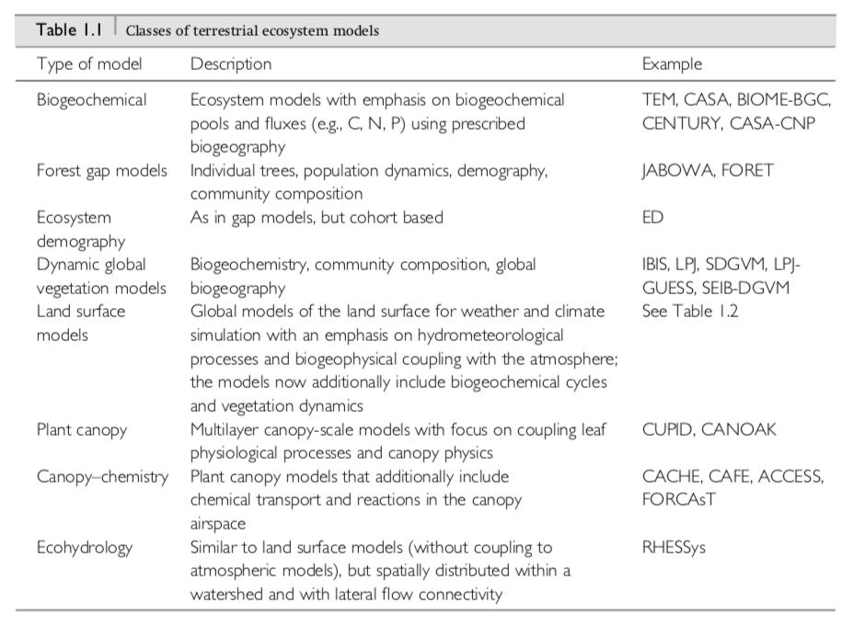
Different classes of TEMs
Bonan, 2019

Slide 12
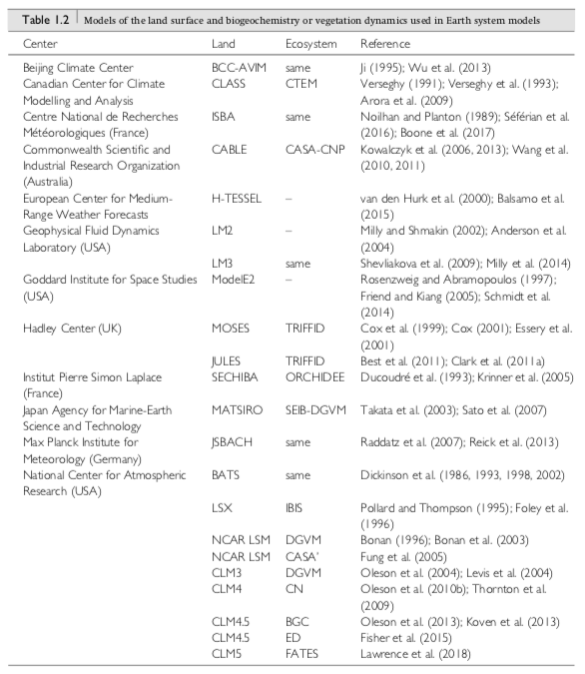
Common terrestrial models used in ESMs
Bonan, 2019

Slide 13
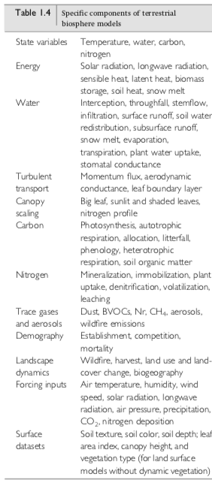
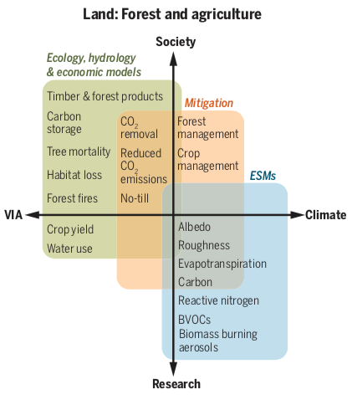
Summary of main TEM processes
Bonan (2019) and Bonan and Doney (2018), Science

Slide 14
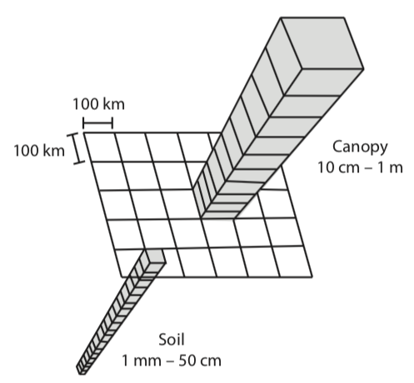
Practical considerations of running a TEM
Spatial resolution: at global scale typically >0.5x0.5° (~50x50km)
When coupled with ESM → more on order of 1-3°
Model calculates all processes for each 3D grid cell
Vertical layers in canopy and in soil
Not much lateral exchange between grid cells on land except for water flows
Also loop over PFTs or soil types
Longitude and latitude grid
Bonan, 2019

Slide 15
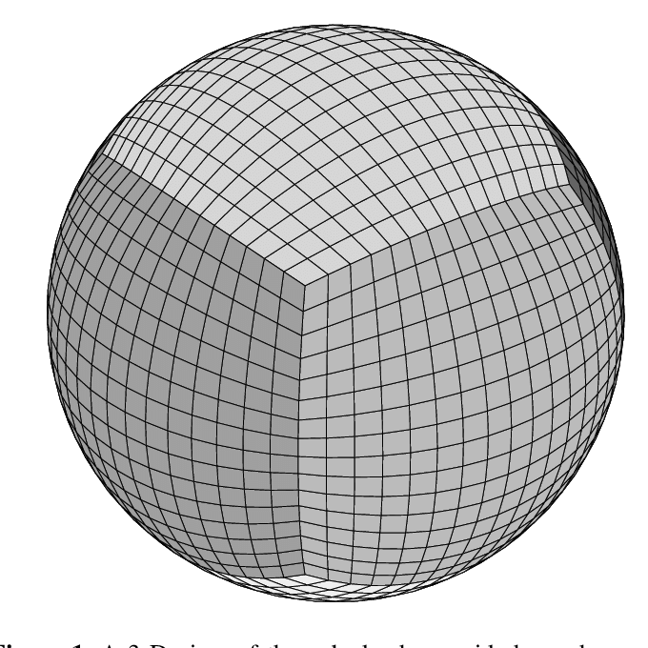
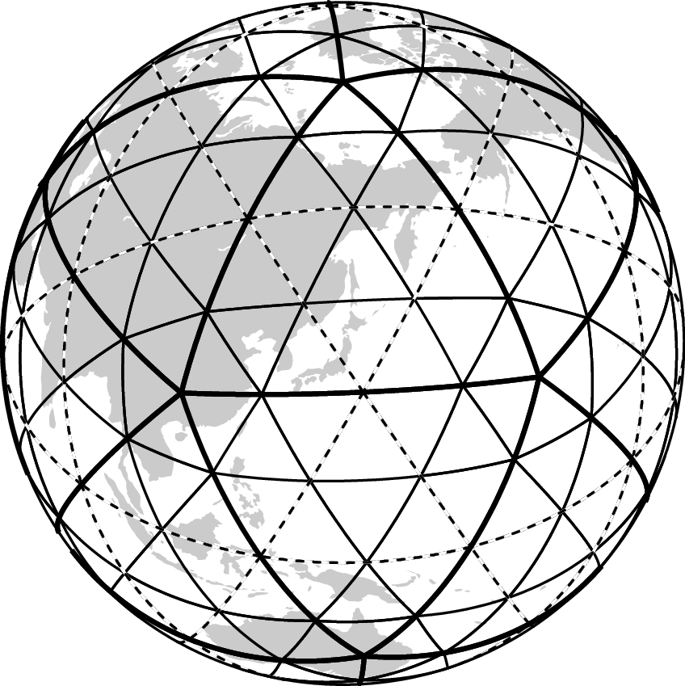
Increasingly common to use cubed-sphere (left) or isodecahedral (right) grids.

Slide 16
Practical considerations of running a TEM
Timescales → have to break up time into manageable “chunks”
Typically climate and “fast” land processes (photosynthesis, energy budgets, hydrology) calculated at 30 minute time step
”Slower” land processes (C allocation and turnover, tree mortality, species competition) calculated at daily or greater timesteps
Take information from current timestep and calculate prediction for next timestep:
X^{t+1} = f(X^{t})
Shorter timesteps = improved model accuracy/reliability (need better computing power)

Slide 17
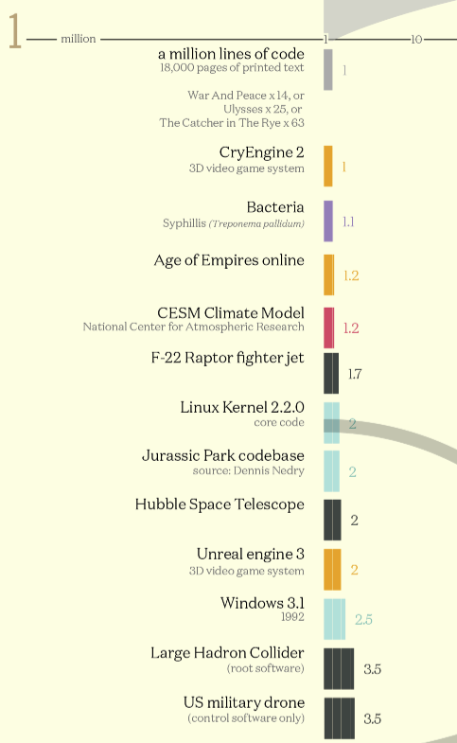
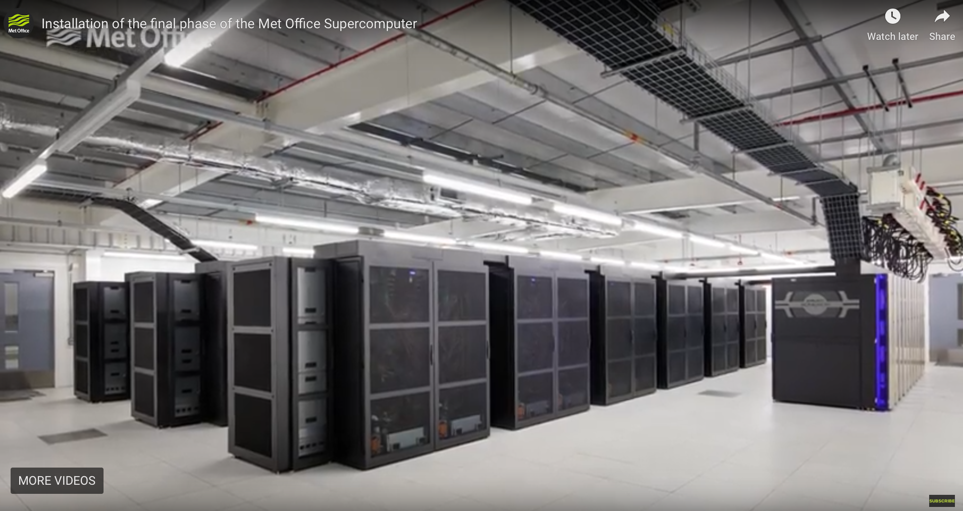
Practical considerations of running a TEM
ESMs contain over a million lines of code (18,000 pages of printed text!) → TEMs several hundred thousand lines.
Typically written in Fortran90.
Requires a supercomputer (size of tennis court) to run and store terra- to petabytes of simulation outputs
Often solutions to equations are solved “numerically”, which means there are numerical methods we used to approximate the solution → can take 100s to 1000s iterations
Met Office Hadley Centre’s three new Cray XC40 supercomputersare together capable of 14,000 trillion calculations a second → this picture shows a 1/3 of them
https://informationisbeautiful.net/visualizations/million-lines-of-code/

Slide 18
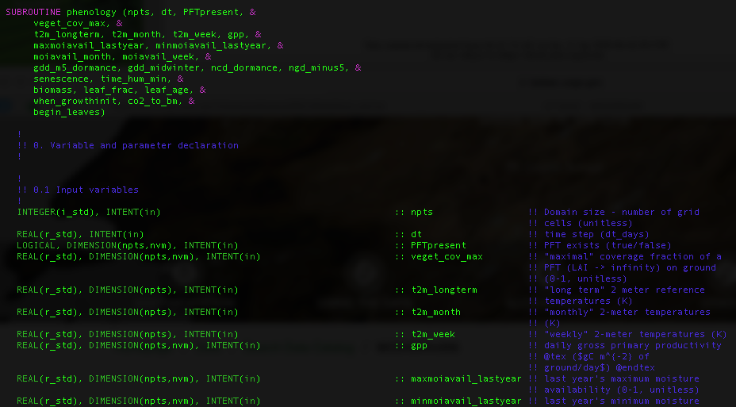
Example code (Most models written in Fortran90)

Slide 19
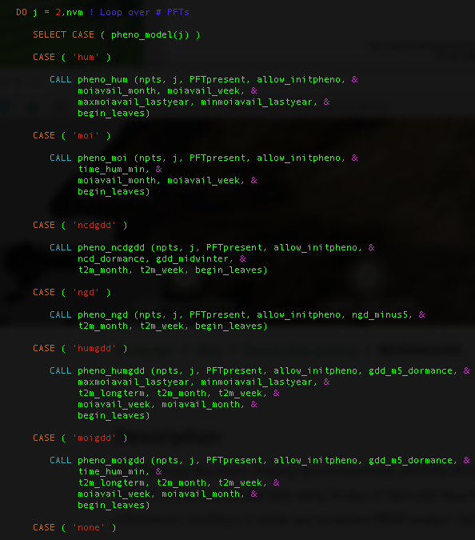
Example code

Slide 20
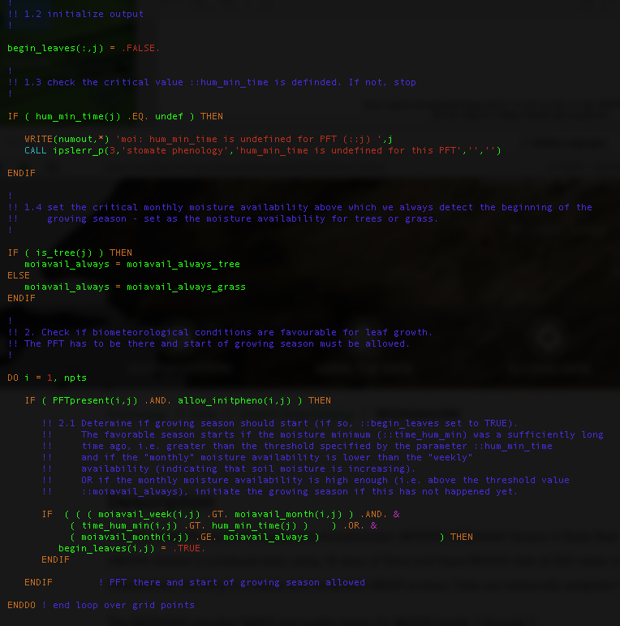
Example code

Slide 21
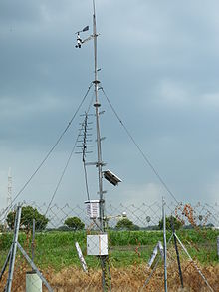
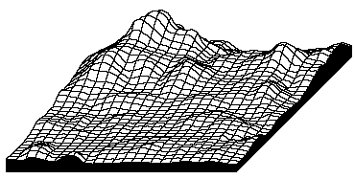
Practical considerations of running a TEM
Inputs:
Climate “forcing” often from climate “renalayses”:
Air temperature
Rainfall
Wind
Incoming short and longwave radiation
Humidity
Surface Air Pressure
Vegetation (if static) and soil type
Global atmospheric CO₂ concentrations
Topography
Default parameter values
https://climatedataguide.ucar.edu/climate-data/atmospheric-reanalysis-overview-comparison-tables

Slide 22
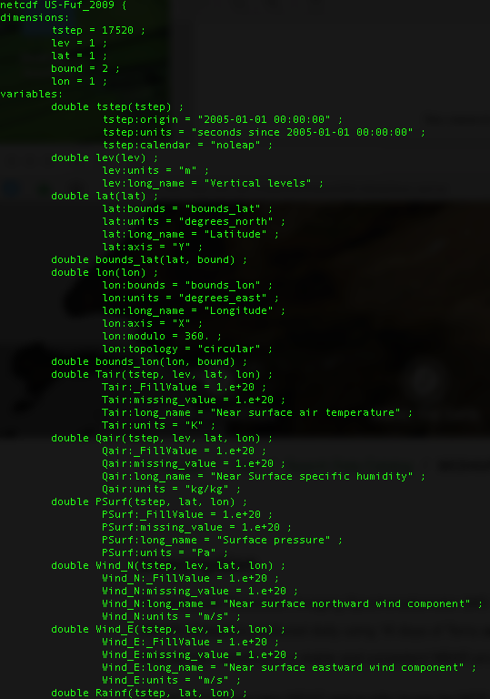
Practical considerations of running a TEM
Outputs → any predicted variable!
Energy, Carbon and water fluxes (GPP, NEE, latent heat flux)
Carbon and water stores (e.g. woody biomass, soil C and soil moisture)
Leaf area index
Surface temperature
Snow cover
etc
Inputs and outputs often stored in netCDF files
Just have to consider computational storage requirements
Tradeoff between #variables and time-step
Typically, at global scale, monthly-to-annual
At site scale, diurnal (30 min) to daily

Slide 23
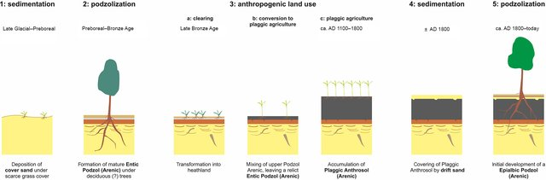
Practical considerations of running a TEM
Spin-up:
models start from “bare rock”
Build up soil and aboveground biomass (as well as water stores) slowly over time
Models cycle over historical climate forcing data
Source: https://www.soil-journal.net/2/537/2016/

Slide 24
Practical considerations of running a TEM
Spin-up:
models start from “bare rock”
Build up soil and aboveground biomass (as well as water stores) slowly over time
Models cycle over historical climate forcing data
But difficult to know exact land use history and past climate → therefore, these “initial conditions” are sources of uncertainty…
Source: https://www.soil-journal.net/2/537/2016/

Slide 25
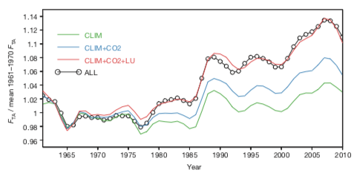
Types of experiments
Depends on way model being used / questions being asked
For a “global change” experiment – 3 periods:
Spin-up (pre ~1850s)
→ Cycling of climate forcing and “pre-industrial” [CO₂] of ~270ppm
Historical or “transient” run (~1850s – present)
→ best estimate of changes over time, based on observed climate, CO₂, LUC
Predicted variables can be compared to independent observations
“Attribution” studies → CO₂ vs CLIM vs LUC
Future run (~2010s to 2100)
Based on “scenarios” (Representative
Concentration Pathways - RCPs)
Attribution or factorial analysis from Zeng et al. (2014) Nature
Notes:
RCPs based on socio-economic decisions

Slide 26
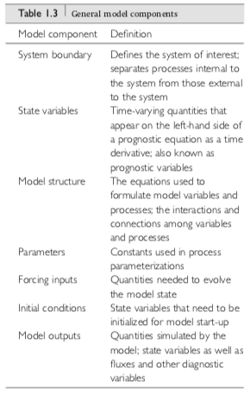
Model components
Bonan, 2019

Slide 27
Parameterization
Differences between knowledge of processes and how the processes are implemented in a TEM
Often simplifications and/or generalizations of real-world processes (called model parameterization) because:
Not enough computational resources
Need a numerical solution to solve equations
Processes poorly understood
Not enough data to describe process/system well
To account for sub grid-scale processes → e.g. topography, land/vegetation cover heterogeneity
Don’t know if process is important enough

Slide 28
Sources of uncertainty
Parameters (fixed values)
Also how we link parameters to broad PFTs
Model structure (uncertain or unknown processes) → including “parameterization”
Climate forcing
Initial conditions
Bugs!
→ Often tradeoff between complexity and uncertainty…

Slide 29
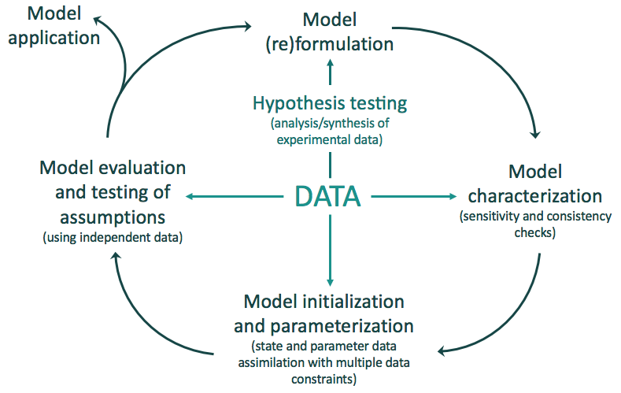
Model development cycle
Models also participate in “model intercomparison projects” (MIPs)
Difference between model evaluation/benchmarking and data assimilation → latter addresses uncertainty
Model tuning
Adapted from Williams et al. (2009)

Slide 30
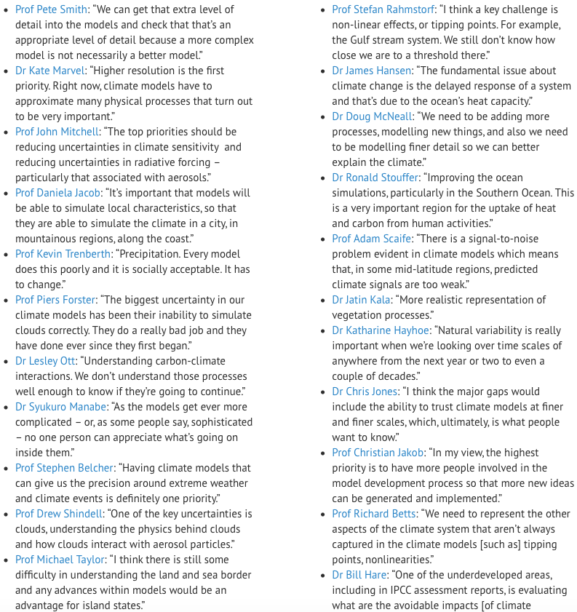
Future development of TEMs/ESMs
https://www.carbonbrief.org/in-depth-scientists-discuss-how-to-improve-climate-models

Slide 31
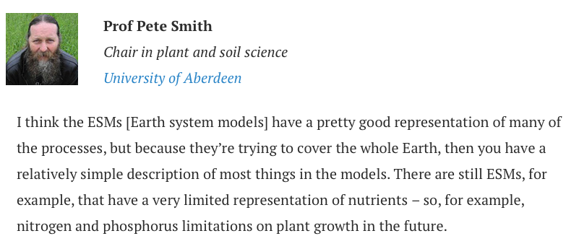

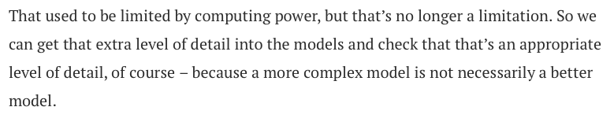

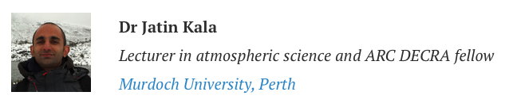
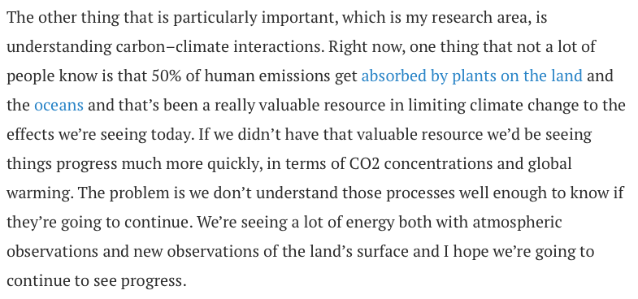

Slide 32


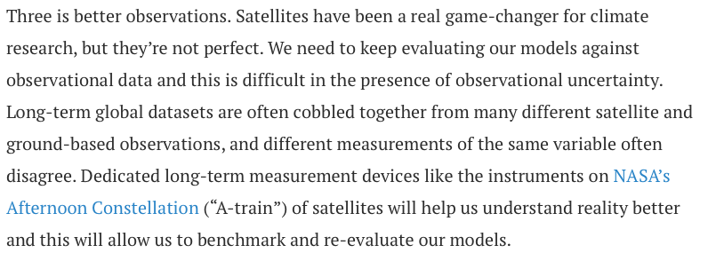
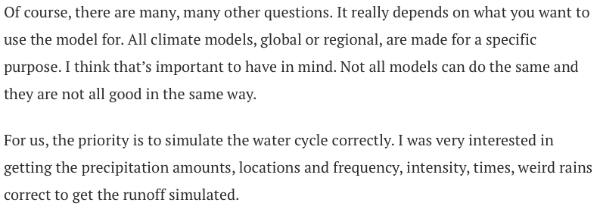
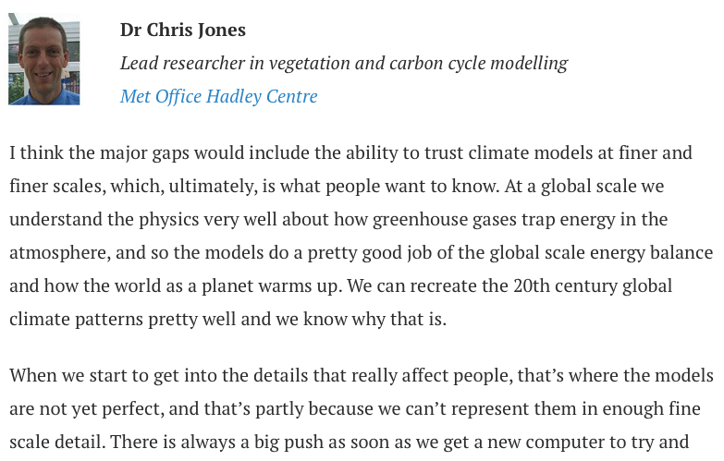
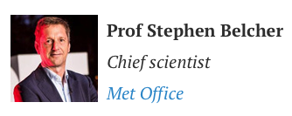
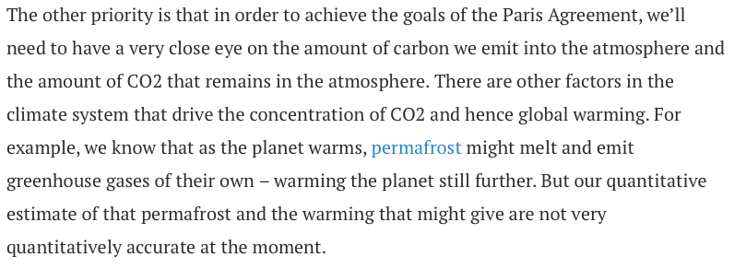

Slide 33
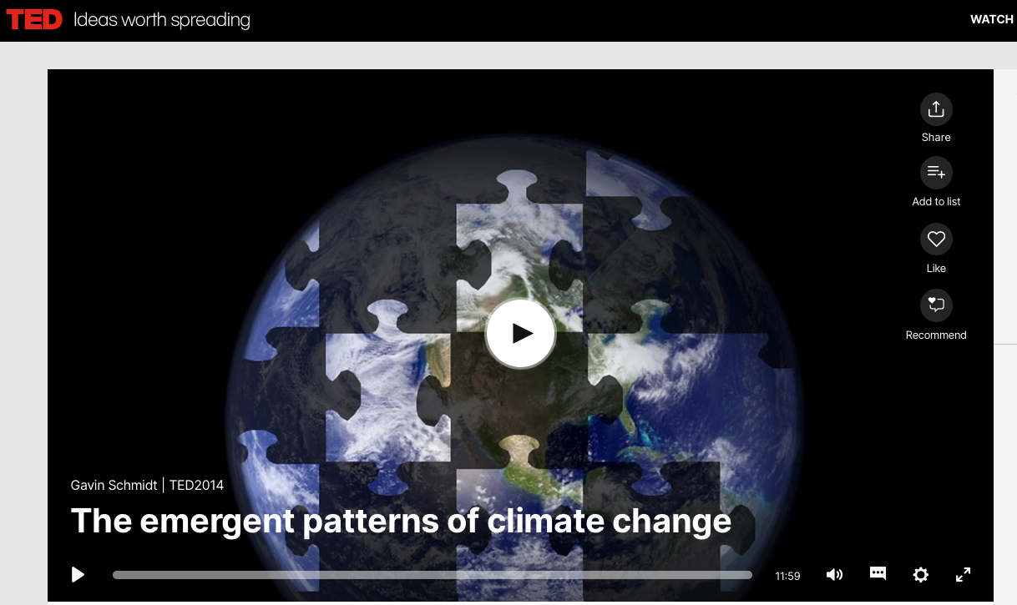
TEMs within ESMs: Modeling the whole climate system
https://www.ted.com/talks/gavin_schmidt_the_emergent_patterns_of_climate_change#t-165009

Slide 34
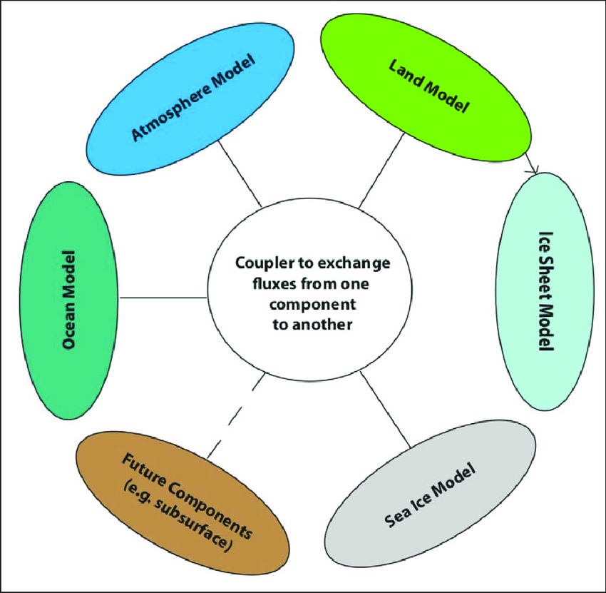
How do TEMs fit into Earth System Models?
https://www.carbonbrief.org/qa-how-do-climate-models-work

Slide 35
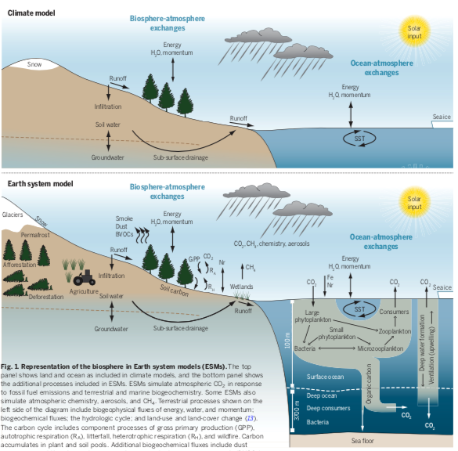
Difference between climate models and earth system models
Bonan and Doney, 2018, Science

Slide 36
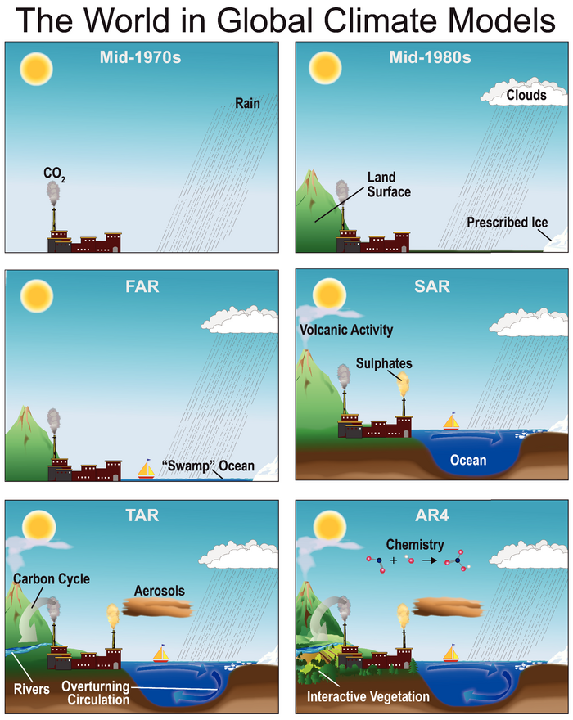
History of coupled-climate modeling over time
General Circulation Models (GCMs)
(Also called Global Climate Models)
Earth System Models (ESMs)
More earth system components added in…
Key addition: LAND/BGC
Illustration of the processes added to global climate models over the decades, from the mid-1970s, through the first four IPCC assessment reports: first (“FAR”) published in 1990, second (“SAR”) in 1995, third (“TAR”) in 2001 and fourth (“AR4”) in 2007. (Note, there is also a fifth report, which was completed in 2014). Source: IPCC AR4, Fig 1.2
From https://www.carbonbrief.org/qa-how-do-climate-models-work
Notes:
GCMs → flows of air, water and heat in 3D (sometimes only within oceans or atmosphere separately). Also AOGCMs that couple both → exchange between ocean and land.
Also RCMs..

Slide 37
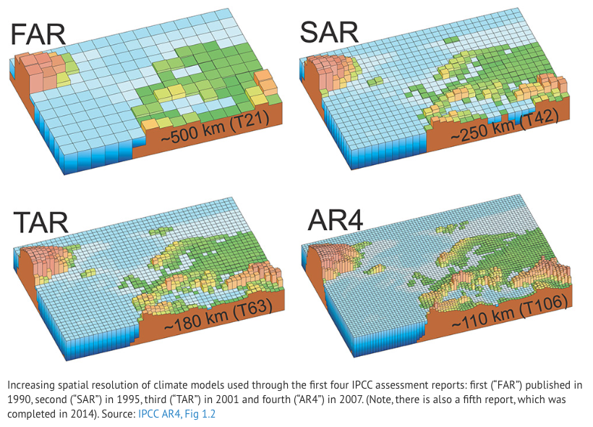
History of coupled-climate modeling over time
From https://www.carbonbrief.org/qa-how-do-climate-models-work

Slide 38
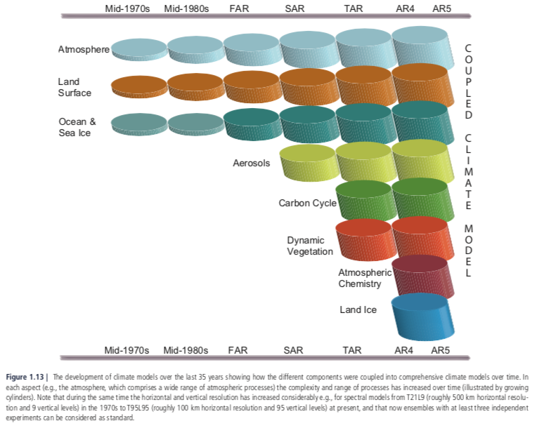
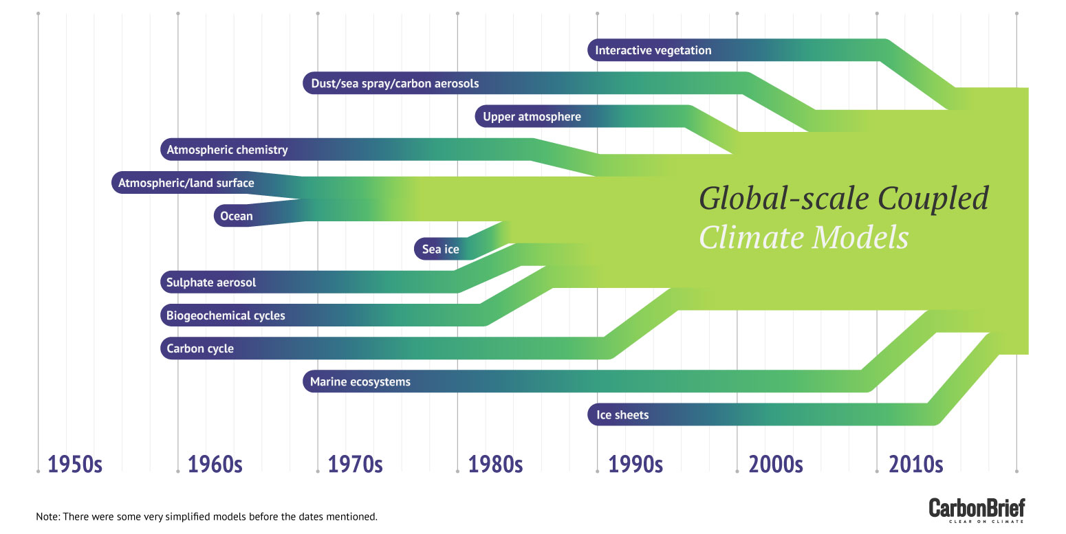
History of coupled-climate modeling over time
IPCC AR5 WG1

Slide 39
Integrated Assessment Models
Key to future climate projections
Simulate impact of socio-economic and political decisions on CO₂ emissions (also population change etc)
IAM projections of radiative forcing from CO₂ emissions then used to “drive” ESMs, which in turn give future climate projections
In IPCC we run “scenarios” representing different possible paths we can take in reducing (or not) anthropogenic CO₂ emissions

Slide 40
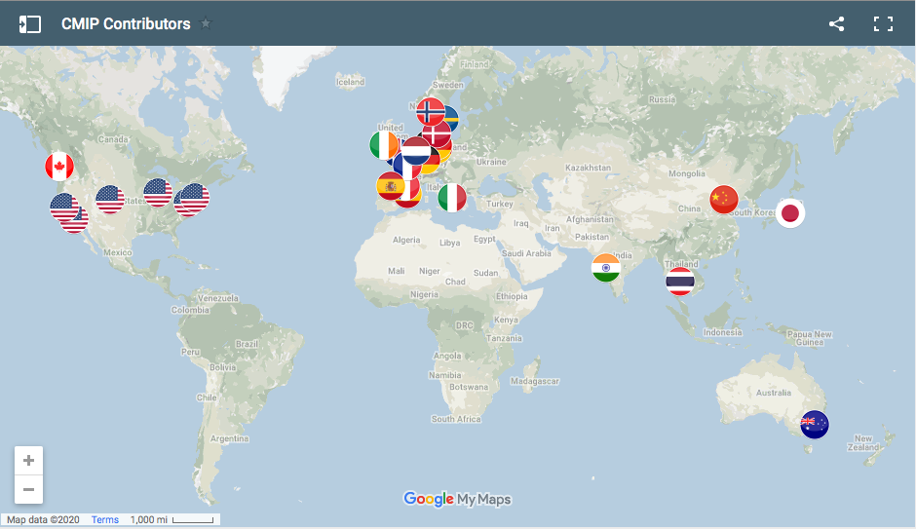
ESM modeling centers worldwide
>25 major modeling centers worldwide.
~6 in US, including: NCAR CESM, DOE E3SM, NASA GISS E2, NOAA GFDL
ESM modeling centers contributing to CMIP6/IPCC AR6. Source: https://pcmdi.llnl.gov/CMIP6/

Slide 41
CMIP (Coupled Modeling Intercomparison Project)
CMIP set-up to better understand past, present and future changes in climate.
Harmonize model experiments so that different models can be more effectively compared.
Coupled – means coupled atmosphere, ocean, land, sea ice in ESM
Started in mid 90s; Run every ~5-7 years.
Independent from IPCC; however, simulations now form basis of physical science basis in IPCC (and other) reports.
Short perspective: history of CMIP and overview of CMIP6 → over time, more models and more experiments
Latest is CMIP6 → will go into IPCC AR6.
Responsibility of WCRP (World Climate Research Program) Working Group on Coupled Modeling based at WMO in Geneva. (History of WCRP).
Outputs at PCMDI (Program for Climate Model Diagnosis and Intercomparison) and ESFG (Earth System Grid Federation).

Slide 42
CMIP5
First time IAMs produced Representative Concentration Pathways (RCPs - e.g. RCP2.6, 4.5, 6.0, 8.5) based on socio-economic scenarios for CMIP and the IPCC AR5 report
Additional experiments included interactive carbon (C⁴MIP), atmospheric chemistry and paleoclimate
~2 dozen modeling groups

Slide 43
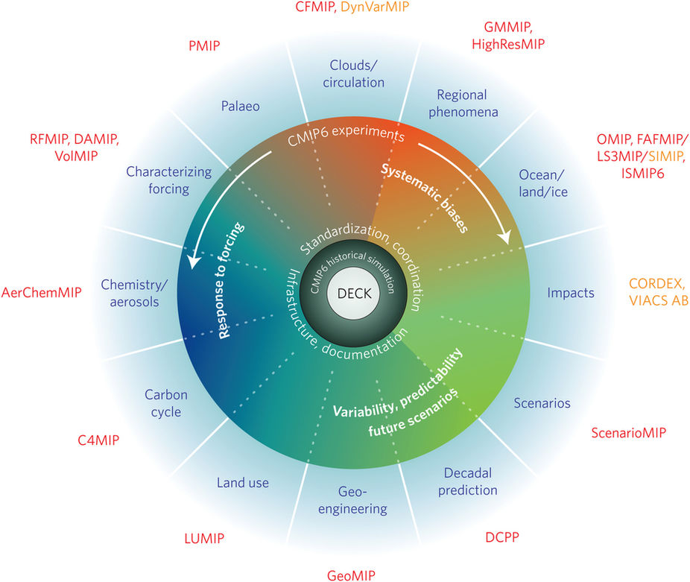
Latest (ongoing) simulations: CMIP6
In past CMIPs, only a relatively few set of simulations.
New design in CMIP6:
Core set that every center has to complete (so-called “DECK” - Diagnostic, Evaluation, and Characterisation of Klima)
5 baseline experiments; 49 groups
Many more optional experiments/MIPs
23 endorsed; driven by community
Designed to address specific scientific questions
ScenarioMIP: test different socio-economic decisions
Developed with IAM and Impacts communities
Shared socioeconomic pathways (SSPs) + RCPs
Other MIPs (past and present) and TRENDY
Special issue in the journal Geoscientific Model Development on CMIP6 design and MIPs: https://www.geosci-model-dev.net/special_issue590.html
Notes:
5 baseline DECK experiments:
1) Historical sea surface temperature forced atmospheric model
2) Pre-industrial control
3) 4xCO2 abrupt increase (abrupt)
4) 1% increase in CO2 per year
5) Historical simulation from 1850 to the present

Slide 44
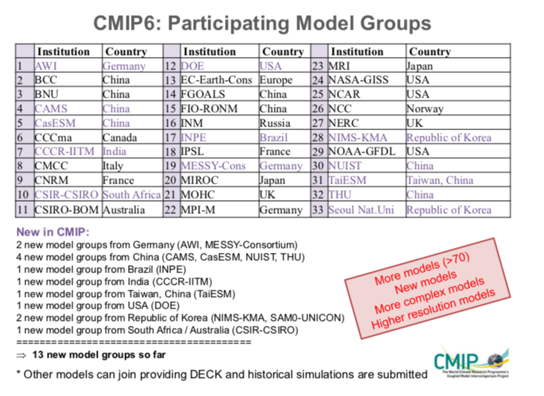
https://www.wcrp-climate.org/images/modelling/WGCM/CMIP/CMIP6FinalDesign_GMD_180329.pdf

Slide 45

CMIP6 Timeline
Though ~1 yr behind schedule…not all models will be included in AR6
So far, many models have a higher climate sensitivity (greater warming)…

Slide 46

CO₂ emission scenarios in CMIP6
https://www.carbonbrief.org/cmip6-the-next-generation-of-climate-models-explained
SSP3.4: limit to ~2-3°C warming

Slide 47

Warming ranges for different scenarios (predicted by models submitted to CMIP6 so far…)
https://www.carbonbrief.org/cmip6-the-next-generation-of-climate-models-explained

Slide 48

https://www.carbonbrief.org/cmip6-the-next-generation-of-climate-models-explained

